Slide 1
Welcome to the 2020 Berkshire Suicide Prevention Conference
Thursday, September 10, 2020
8:30am – 4:30pm

Slide 2
Thank you to all our Sponsors and Partners
American Foundation for Suicide Prevention MA Chapter
The Austen Riggs Center
Berkshire Coalition for Suicide Prevention
Berkshire Health Systems
The Brien Center
Massachusetts Department of Public Health Suicide Prevention Program
Massachusetts Coalition for Suicide Prevention
NAMI Berkshire County

Slide 3
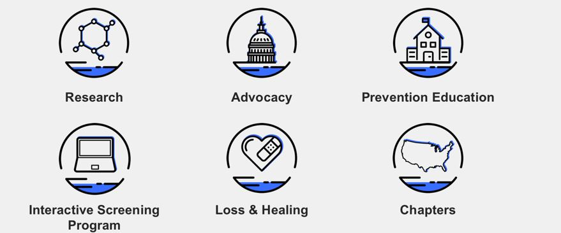

Slide 4
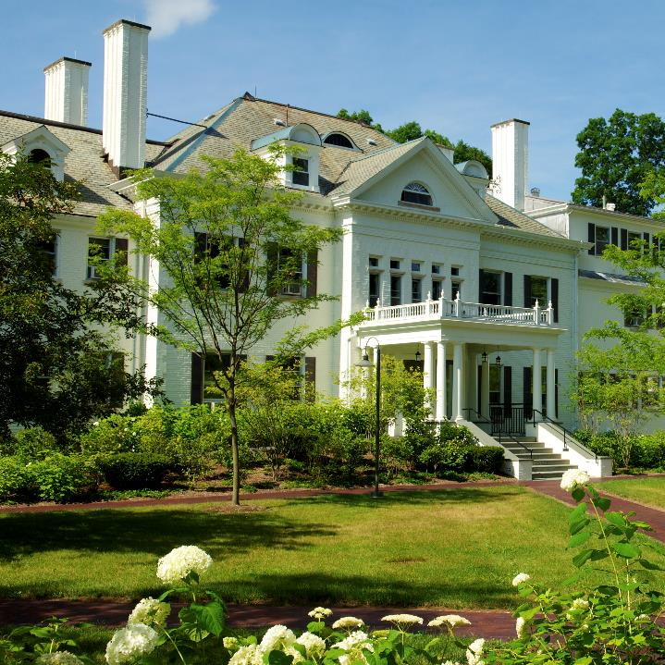
RIGGS is a therapeutic community, open psychiatric hospital, and center for education and research, promoting resilience and self-direction in adults (18+) with complex psychiatric problems.
Follow us and engage online:
www.austenriggs.org/blog
Riggs is proud to sponsor the BCSP’s 2020 Virtual Suicide Prevention Conference
@AustenRiggsCenter
@AustenRiggs

Slide 5
Resources
Survivor Support
Training
Education
berkshirecoalition.org

Slide 8
Suicide Prevention Program

Slide 9
Our mission is to reduce suicide and self-harm in Massachusetts through education and advocacy.
Join us for:
*Bi-Monthly General Membership meetings
*MCSP Alliance for Equity meetings *Annual events
*Webinars and panel discussions
*Advocacy, collaboration and public awareness efforts
To get involved with the MCSP, email info@masspreventssuicide.org
Follow us on Facebook @masspreventssuicide and Twitter (MCSPPrevSuicide)
www.masspreventssuicide.org

Slide 11
Thank you to our conference planning committee:
Brenda Bahnson
Brenda Butler
Christine Callahan
Peggy Morse
Anna Paladino
Sandy Ryan
Lynne Vanderpot
Lee Watroba

Slide 12
Thanks for behind the scenes technical assistance, web and social media work, and Zoom magic:
Alison Lotto
Patricia Shandy
Garnet Williams
Music by www.bensound.com

Slide 13
National Suicide Prevention Hotline 1-800-273-TALK (8255)
Text a Crisis Counselor text TALK to 741741
More resources at www.berkshirecoalition.org

